Slide 1
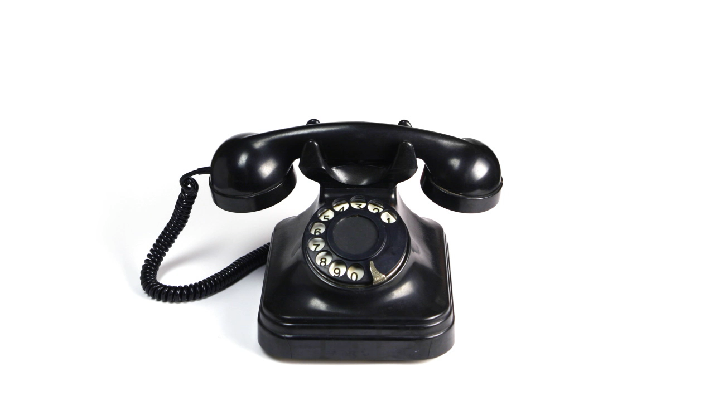

Analog Telephone Physics
Zachary Rohrbach, Avon High School
IN-AAPT Spring Meeting 2023

Slide 2

Exploding the Phone
www.explodingthephone.com

Slide 3

A Basic Microphone & Speaker Circuit
Ampere’s Law
Lenz’s Law

Slide 4

Slightly more complicated….
Ampere’s Law
Lenz’s Law
Amplifier

Slide 5
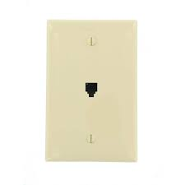
A Simple Self-Contained Telephone Line

Slide 6
A Basic Rotary Telephone
Hearfield, J. (2009). The first one-piece telephone: Type 330. John and Marion Hearfield. http://www.johnhearfield.com/Telephone/One_piece.htm
‌

